Slide 1

SmartMeet: AI-Powered Meeting Summarizer
Sanket Kudale (22106059)
Ranjit Kadam (22106034)
Tejas Kalokhe (22106049)
Sahil Govardhane (22106097)
Project Guide
Prof. Sayali P. Badhan
By

Slide 2
Index
Introduction
Literature Survey of the Existing Systems
Limitations of the Existing Systems
Problem Statement
Proposed System Design
Technologies Stack for Proposed System
Implementation
Conclusion
Future Scope
References

Slide 3
Introduction
Meetings in organizations and institutions often generate lengthy transcripts that are difficult to review. Going through these transcripts is time-consuming and inefficient, while manual note-taking methods are prone to human error and bias. Although automated tools exist, most lack real-time capability, personalization and coherence, limiting their effectiveness in practical use.

Slide 4
Literature Survey
Sr .no | Authors | Title | Abstract | Limitations
1. | Anurag Asthana, Aaron Halfaker, Chieh-Yang He, Jonathan Morgan (2025) | Summaries, Highlights, and Action Items: LLM-Powered Meeting Recap System | Proposed an LLM-based recap tool that generates summaries, highlights and action items for meetings. Focus on usability and evaluation. | LLM-based summaries face coherence issues; high computation and privacy concerns.
2. | Pratiksha Kadam, Shailesh Jadhav (2024) | Minutes of Meeting Generation for Online Meetings Using NLP & ML | Applied NLP + ML techniques for automated meeting minutes. Converted speech to text and extracted key points. | Limited scalability; performance drops in multilingual or noisy environments.
3. | Onkar Shinde, Pranav Borhade, Sahil Gholap, Akshay Dhangar (2024) | Exploring Advances in Meeting Minutes Generation (ConvoLogix Model) | Combined face attendance with meeting summarization using NLP models and feature extraction techniques. | Abstractive summarization is weak; system is domain-specific and lacks generalization.

Slide 5
Sr .no | Authors | Title | Abstract | Limitations
4. | C. Ranjith, Vishnu Priya (2024) | Online Meeting Summarizer and Report Generation using GenAI | Leveraged LLMs like GPT and hybrid methods (SummPip, Graph Fusion) for meeting summarization. | LLMs raise privacy issues; summaries sometimes incoherent for long dialogues.
5. | Aman Singh, Ankit Gautam, Deepanshu, Gautam Kumar, Lokesh Kumar Meena, Shashank Saroop (2023) | Automated Minutes of Meeting Using a Multimodal Approach | Used Whisper AI (ASR) with NLP/transformers for audio + text multimodal summarization. | Struggles with long transcripts and multilingual accuracy; coherence issues.
6. | Riya Gupta, Rahul Sharma, Neha Patel (2023) | Building Real-World Meeting Summarization Systems using LLMs | Examined industrial meeting summarization with GPT-3.5/4, PaLM-2, LLaMA-2. Compared cost, performance and accuracy. | Trade-off between accuracy and computational cost; privacy challenges in real deployment.

Slide 6
Limitations of Existing Systems
Many tools are tied to specific engine or version constraints (e.g., Node.js/ML models), causing deployment issues.
Scalability challenges with long transcripts, as models often truncate input and lose important context.
Lack of real-time summarization, with most systems only generating summaries after meetings.

Slide 7
Problem Statement
Despite progress in meeting summarization, current systems struggle with long, multi-speaker transcripts, often producing generic, incomplete summaries that miss key decisions and action items. There’s a need for a system like Meet-Summarizer that generates structured, role-specific and potentially real-time summaries efficiently.

Slide 8
Goal Alignment
1. SDG 8 – Decent Work and Economic Growth
Target: Increase productivity through technology and innovation.
System automates meeting documentation, boosting team efficiency and reducing manual workload.
2. SDG 9 – Industry, Innovation, and Infrastructure
Target: Enhance scientific research and upgrade technological capabilities.
The use of AI/ML for real-time summarization fosters innovation in business communication tools.
3. SDG 12 – Responsible Consumption and Production
Target: Encourage companies to adopt sustainable practices.
Tool reduces resource waste by eliminating redundant meetings and improving task execution clarity.
4. SDG 4 – Quality Education (if used in academic settings)
Target: Increase skills in information and communications technology.
If deployed in online classrooms or seminars, it helps students retain core content efficiently.
5. SDG 16 – Peace, Justice, and Strong Institutions
Target: Develop effective, accountable, and transparent institutions.
The tool promotes transparent decision-making and better governance in organizations.

Slide 9
Technology Stack for Proposed System
Layer | Technologies
Frontend | React.js, Tailwind CSS
Backend | FastAPI (Python)
AI/ML Frameworks | Transformers, Hugging Face, BERT, BART/ T5, OpenAI Whisper, pyannote.audio, PyTorch,
Speech-to-Text | OpenAI Whisper
Speaker Diarization | pyannote.audio
Summarization Model | Hugging Face Transformers (e.g., BART/T5)
Audio Processing | sounddevice

Slide 10
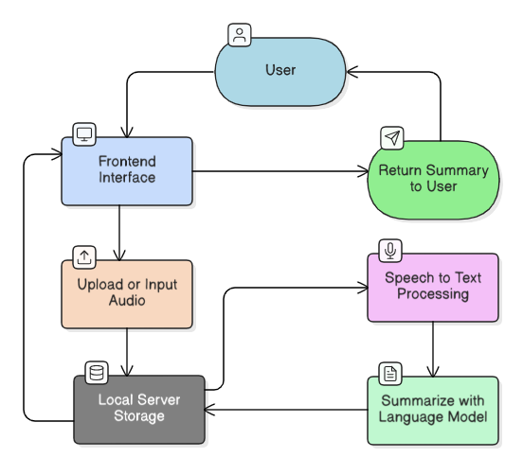
Proposed System Design
Fig. WORKING FLOW

Slide 11
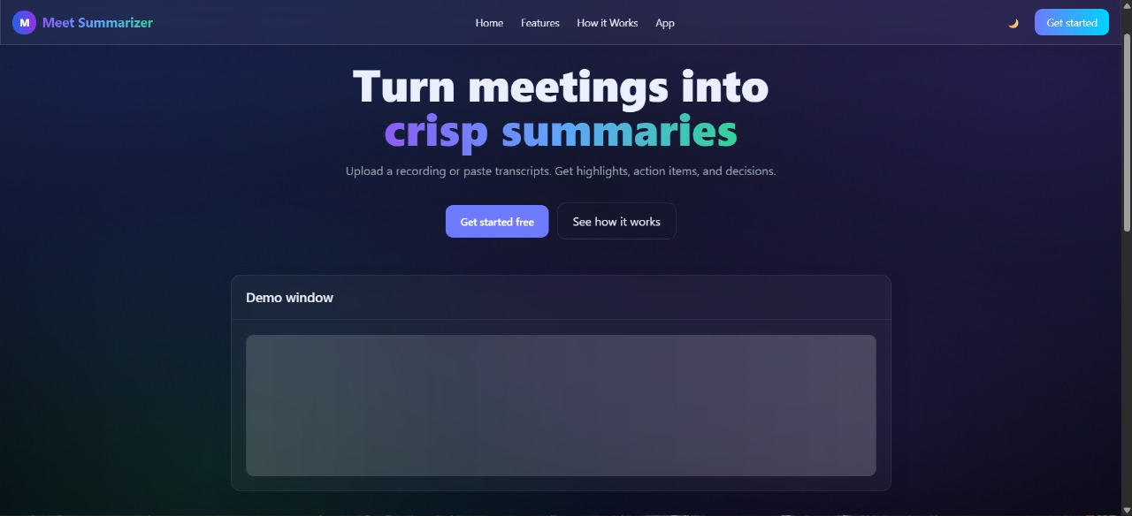
Implementation
Fig.1.1 HOME PAGE

Slide 12
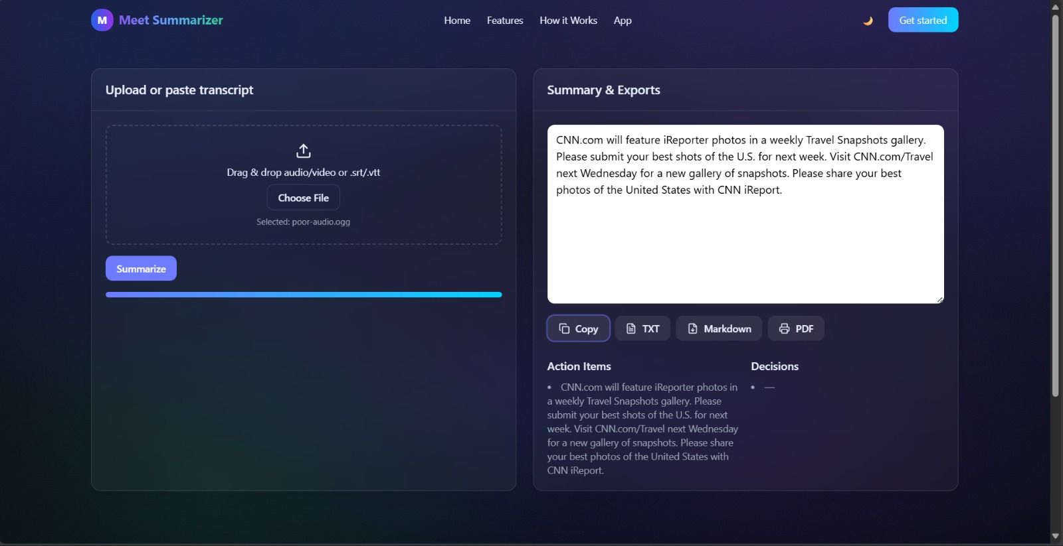
Implementation
Fig.1.4 INPUT/OUTPUT

Slide 13
Conclusion
Meet-Summarizer offers an AI-powered solution for efficiently summarizing long, multi-speaker meeting transcripts. By leveraging advanced NLP techniques, it generates structured, role-specific summaries, highlights key decisions and action items and addresses limitations of existing systems. With potential for real-time processing and seamless deployment, it enhances productivity, ensures clarity in follow-ups and provides a practical tool for organizations to manage meetings effectively.

Slide 14
Future Scope
Integration with popular meeting platforms (Zoom, Google Meet, Teams).
Multi-language and regional language support.
Emotion and sentiment analysis for better context.
Personalized summaries based on user roles.
Cloud-based storage and sharing of meeting summaries.
Voice assistant integration for hands-free access.
Enhanced security and data privacy features.

Slide 15
References
[1] Asthana, Anurag, Aaron Halfaker, Chieh-Yang He and Jonathan Morgan. "Summaries, Highlights and Action Items: Design, Implementation and Evaluation of an LLM-Powered Meeting Recap System." arXiv preprint arXiv:2502.03111, 2025.
[2] Kadam, Pratiksha and Shailesh Jadhav. "Minutes of Meeting Generation for Online Meetings Using NLP and ML Techniques." International Research Journal of Engineering and Technology (IRJET) 11, no. 3 (2024): 2767-2773.
[3] Shinde, Onkar, Pranav Borhade, Sahil Gholap and Akshay Dhangar. "Exploring Advances in Meeting Minutes Generation and Face Attendance Systems (ConvoLogix Model)." International Journal of Engineering Research & Technology (IJERT) 13, no. 3 (2024): 1-6.
[4] Ranjith, C. and Vishnu Priya. "Online Meeting Summarizer and Report Generation using GenAI." In Proceedings of the International Conference on Artificial Intelligence and Machine Learning (ICAIML), pp. 112-118. IEEE, 2024.
[5] Singh, Aman, Ankit Gautam, Deepanshu, Gautam Kumar, Lokesh Kumar Meena and Shashank Saroop. "Automated Minutes of Meeting Using a Multimodal Approach." International Journal for Research in Applied Science & Engineering Technology (IJRASET) 11, no. 12 (2023): 2059-2063.
[6] Gupta, Riya, Rahul Sharma and Neha Patel. "Building Real-World Meeting Summarization Systems using LLMs." International Journal of Advanced Computer Science and Applications (IJACSA) 14, no. 11 (2023): 327-334.

Slide 16
Thank You...!!

